Slide 1
ARM: Global Market

Slide 2


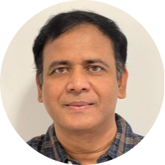
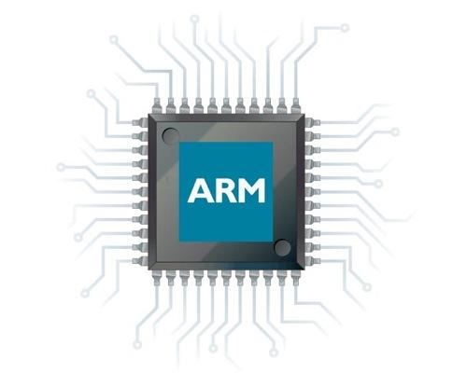




Motivation
Jul 3, 2022

Slide 3

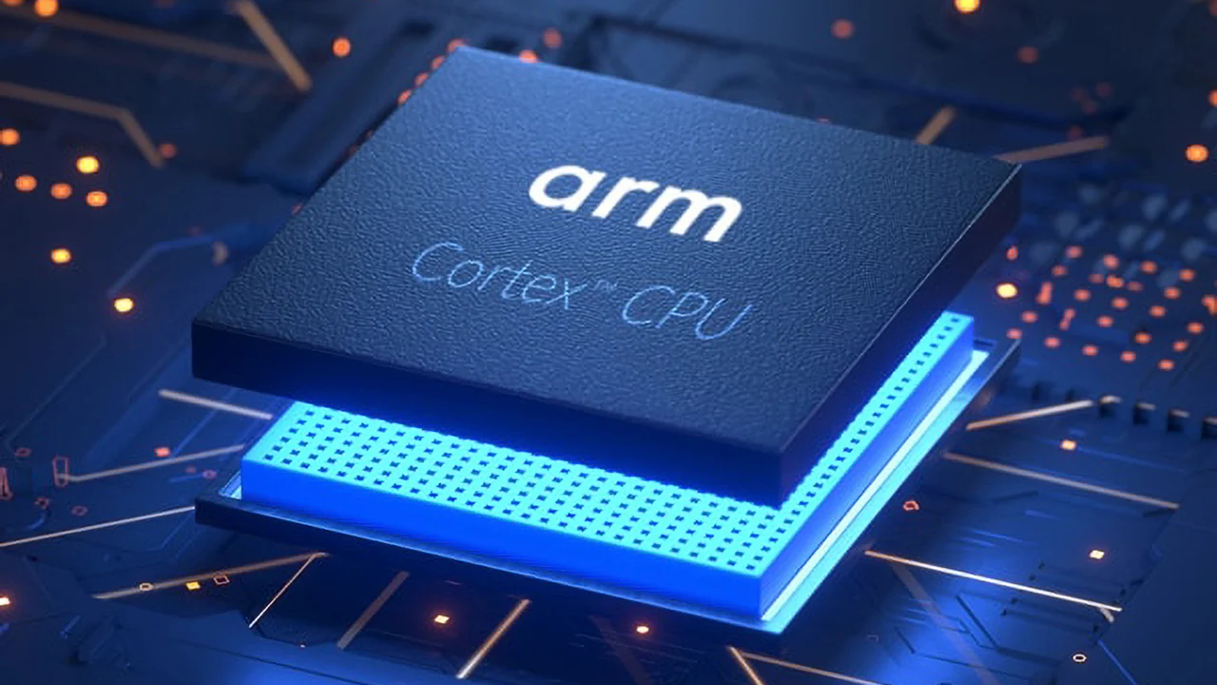
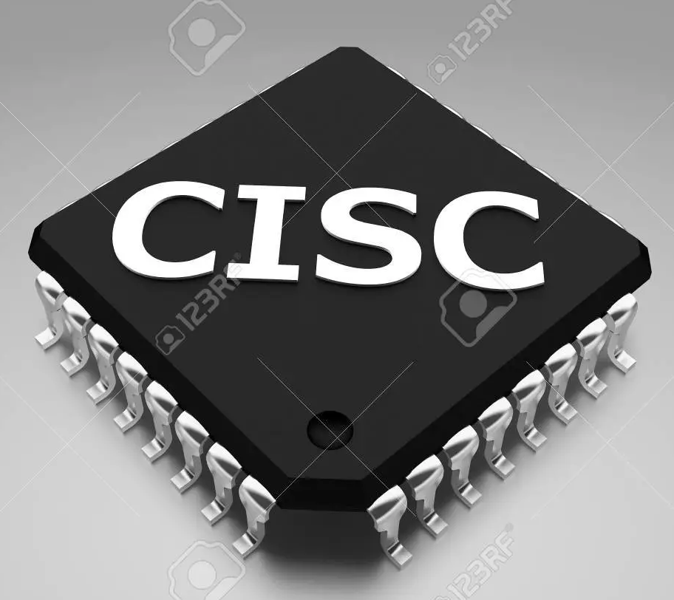

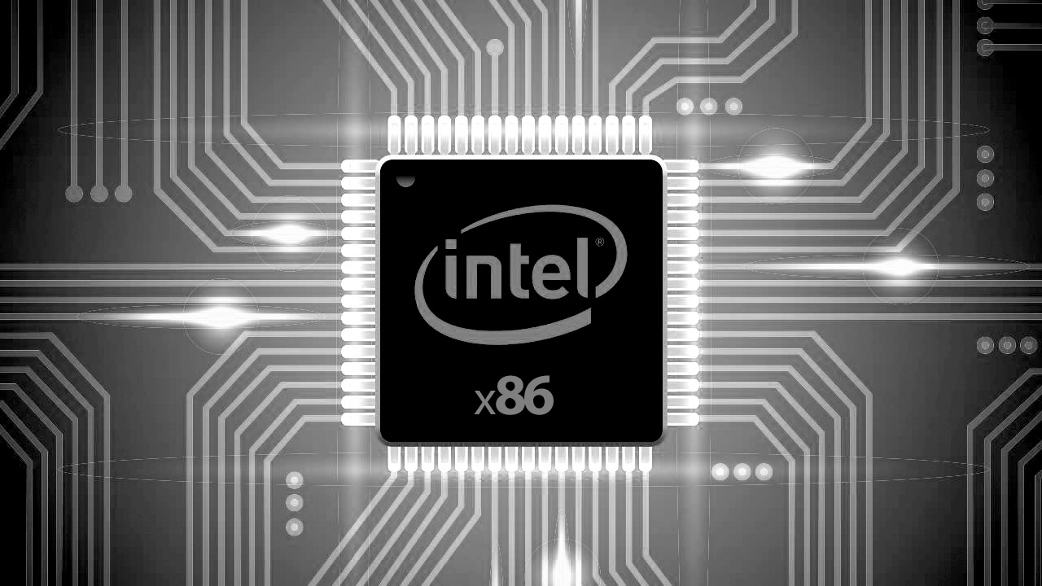


Recent Market Trend
B.Sc Project 2022

Slide 4
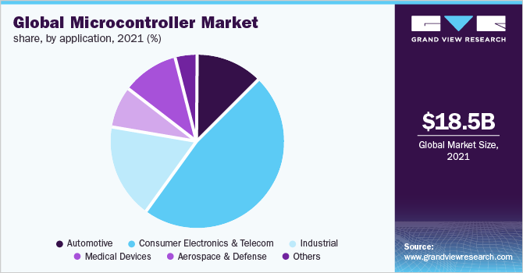
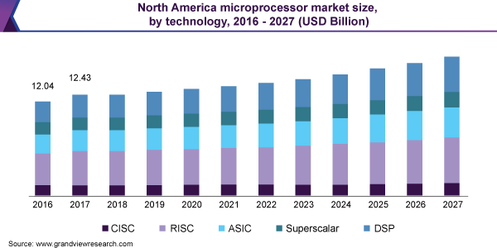
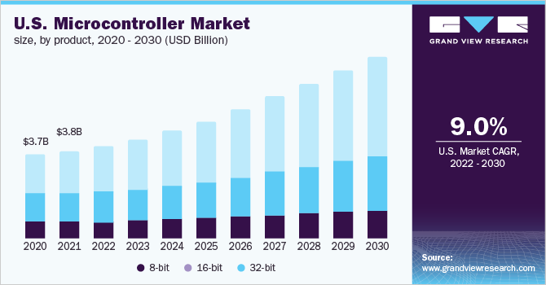
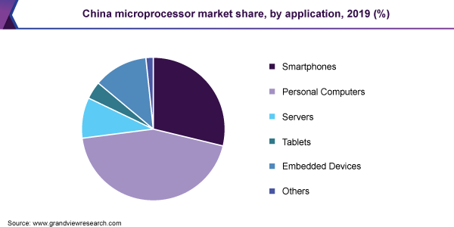
Recent Market Trend
The latest processors are improving every aspect of performance and efficiency.
As much as they are getting faster, they are also more energy-efficient and reliable.
Figure-Global Market of MCU [5]
Figure-Processor Market in NA[2]
Figure-Processor Market in China [3]
Figure-MCU Market in US[4]

Slide 5
Recent Market Trend
18.5 B
The latest processors are improving every aspect of performance and efficiency.
As much as they are getting faster, they are also more energy-efficient and reliable.
Figure-Global Market of MCU [5]
12.43 B
3.8 B
9.0%
Figure-Processor Market in NA[2]
Figure-Processor Market in China [3]
Figure-MCU Market in US[4]

Slide 6
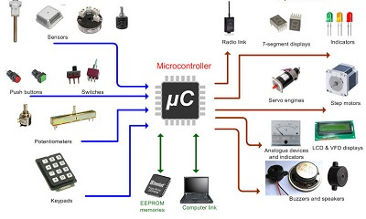


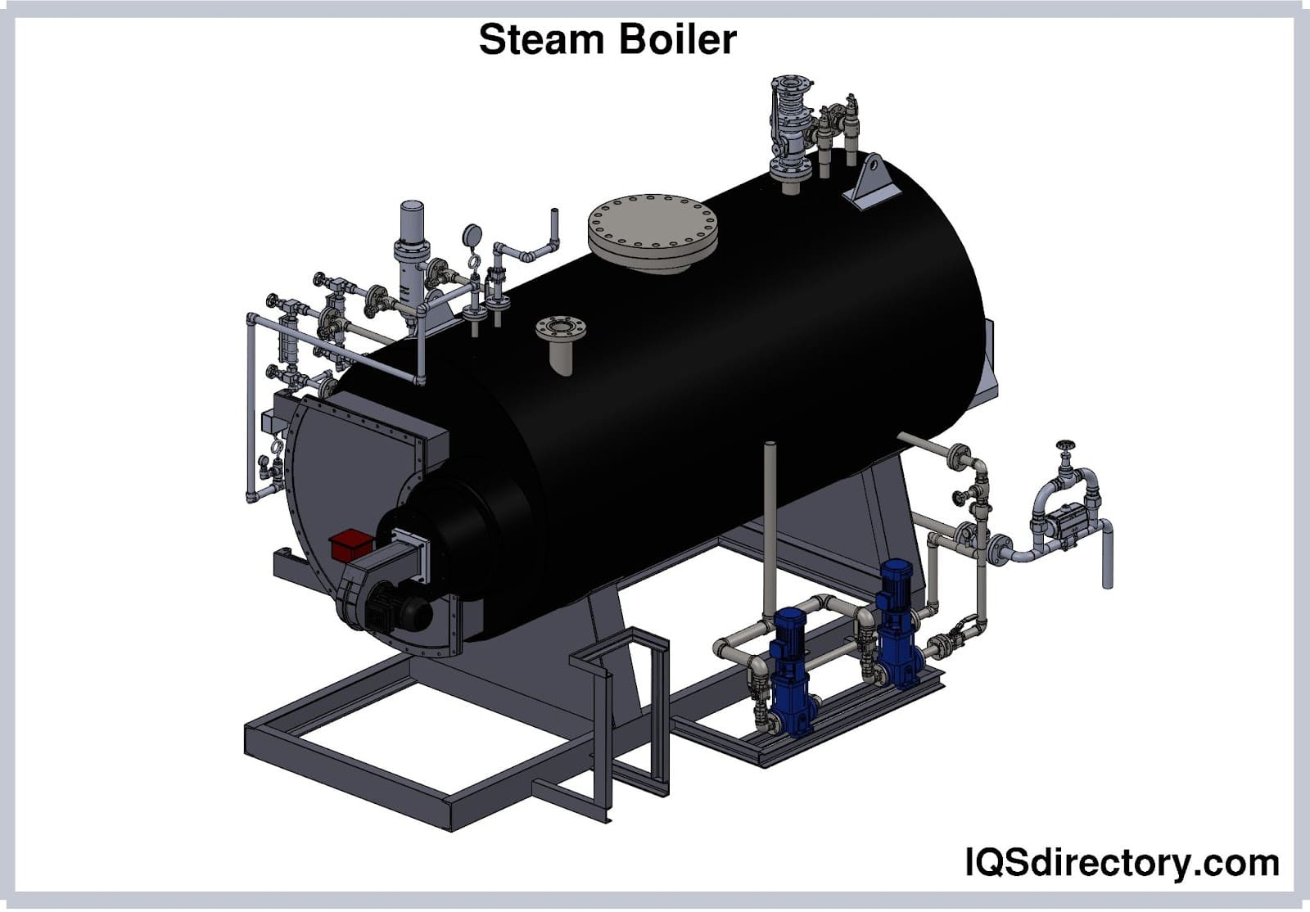

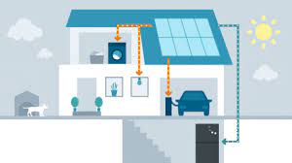
Where we don’t use ARM processor?
B.Sc Project 2022
Notes:
I phone 13 chipser is Apple A15 Bionic ,mursalin will present next slide from here

Slide 7

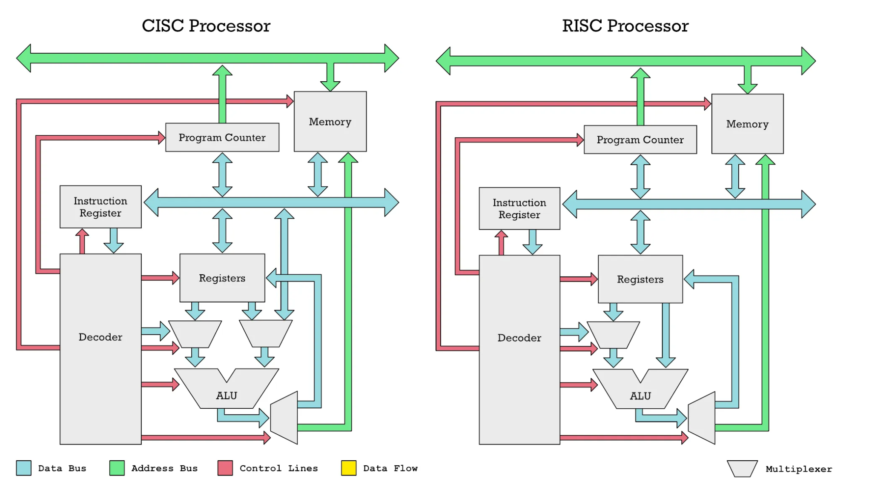
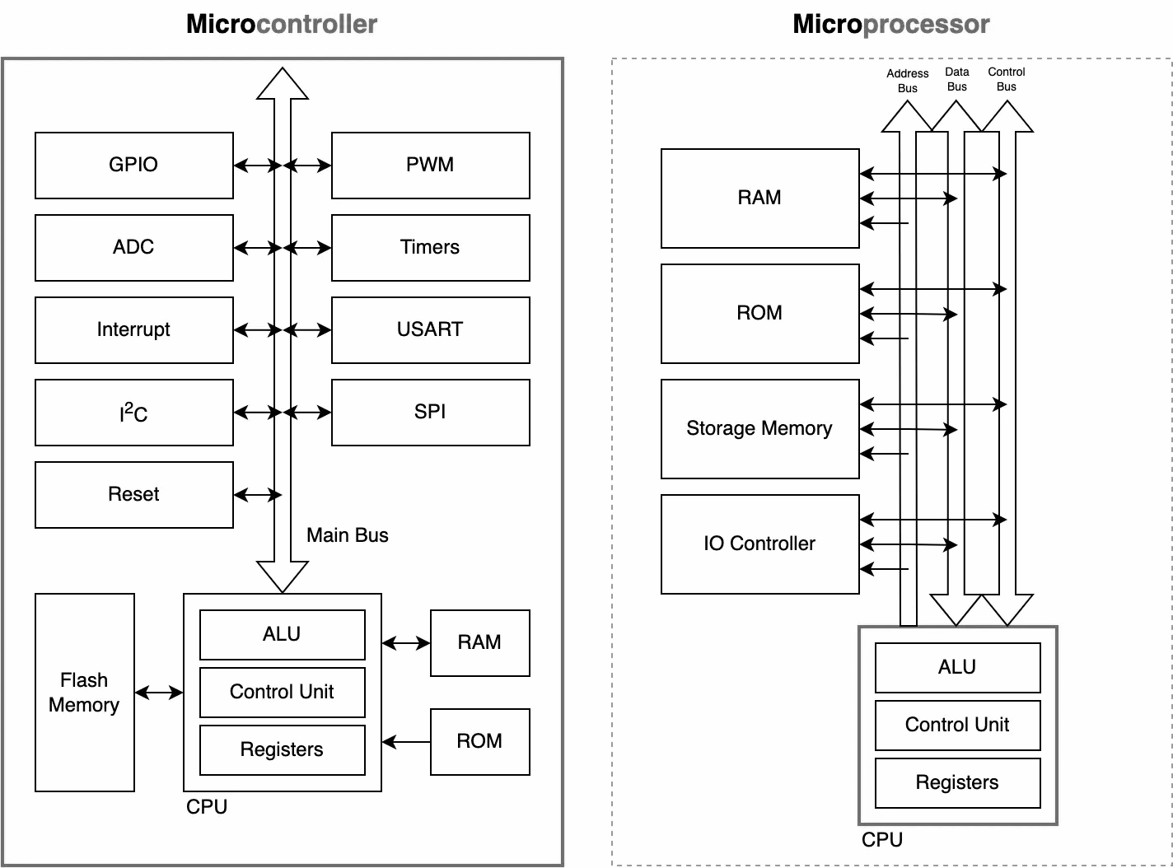

Advantages of ARM Processor over Microprocessors
VS
VS
Figure-Architecture of CISC and RISC processor
Figure-Block diagram of MCU and MPU
Efficiency and Performance
Industry Standard
Availability of Development Tools
Register-Level Programming
B.Sc Project 2022

Slide 8
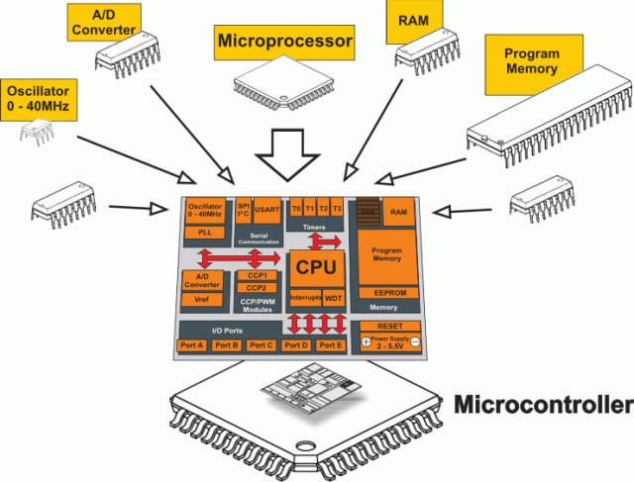
What is Microcontroller?
Figure-: Block diagram of a microcontroller
B.Sc Project 2022

Slide 9

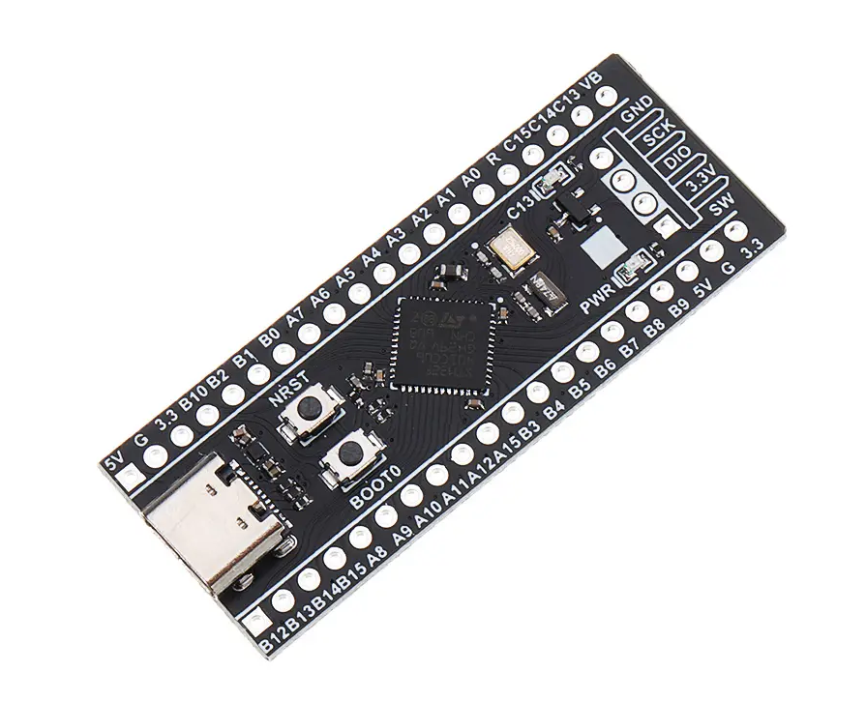
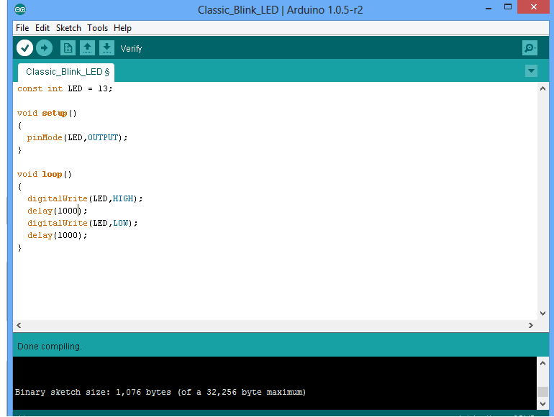
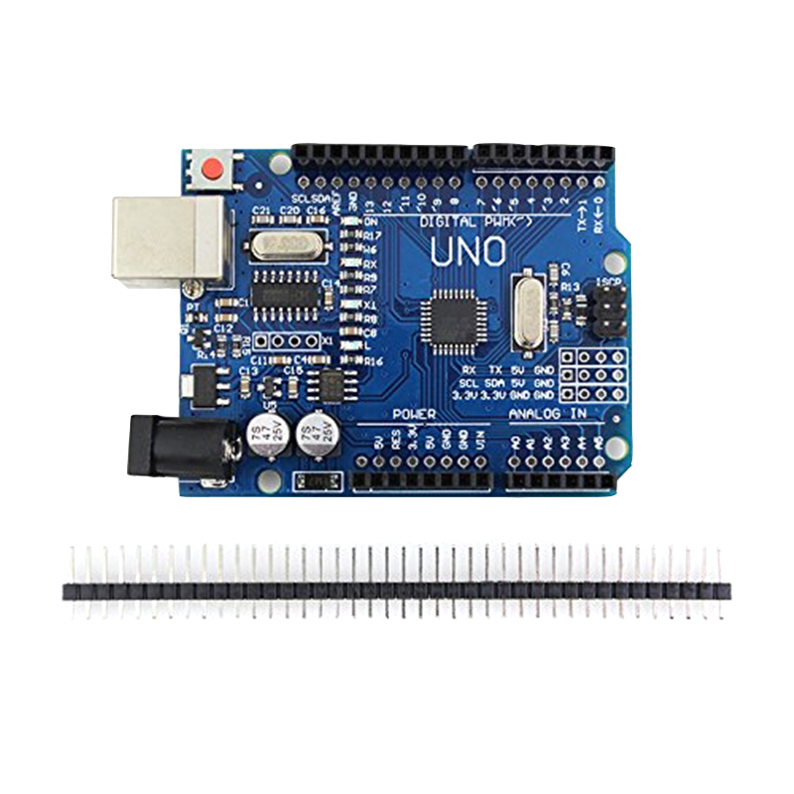
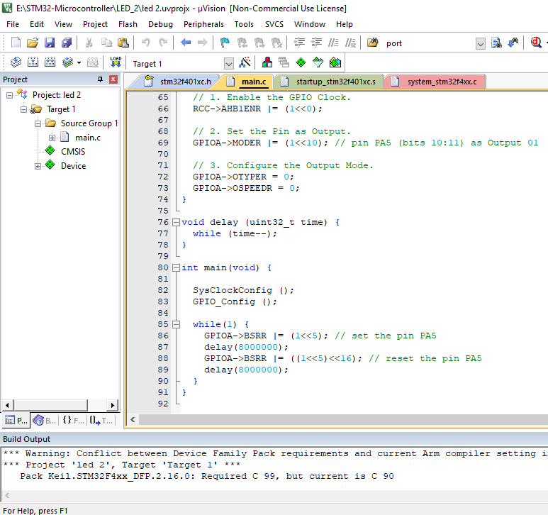

STM32 vs. Arduino: Choosing the Right Platform for Our Project's Requirements
VS
Figure:. Picture of STM32 mcu and arduino
Performance
Extensive Ecosystem
Industry Adoption
Scalability
Flexibility and Customization
Rich Peripheral Set
B.Sc Project 2022

Slide 10

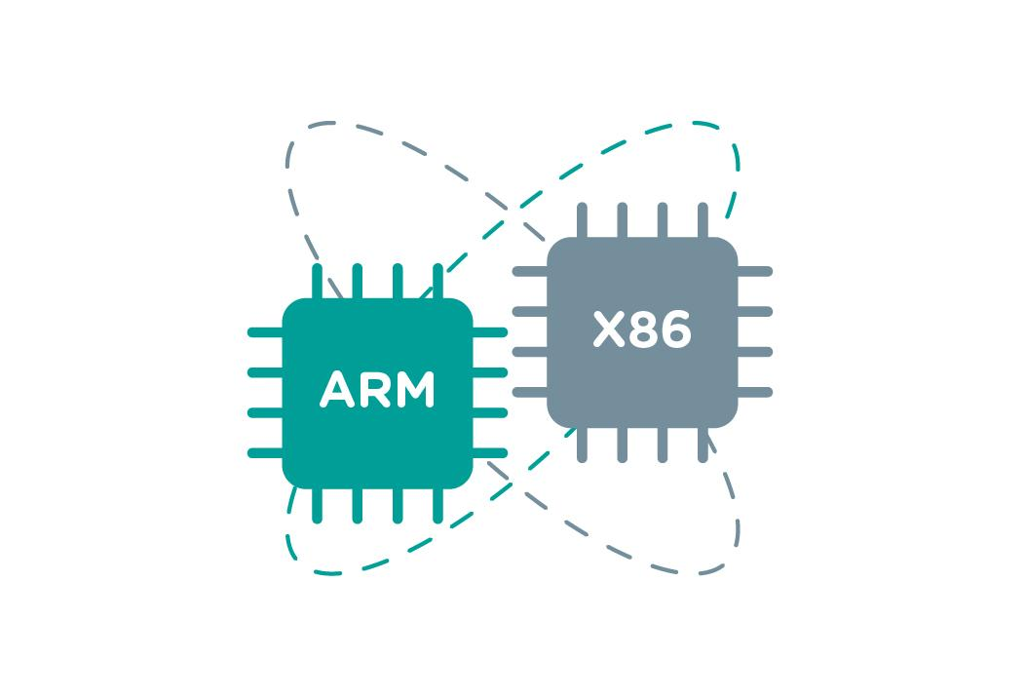
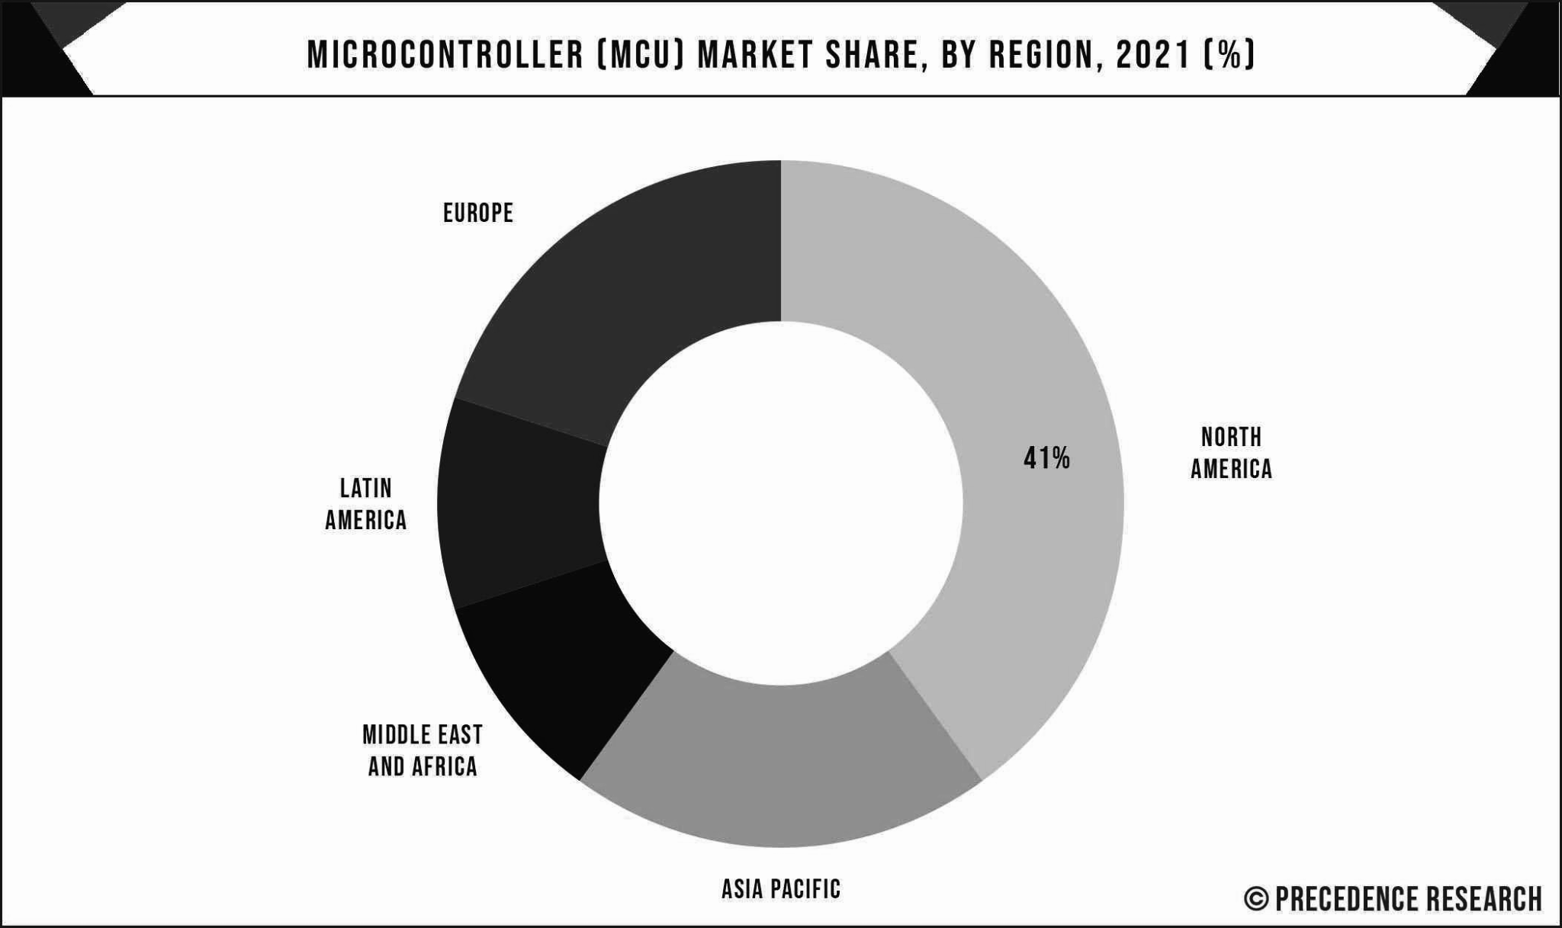
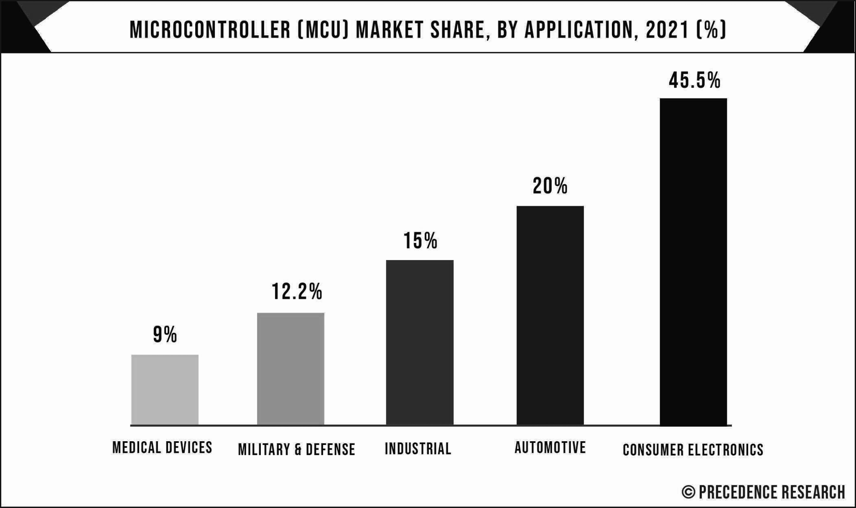
Vision
Career Opportunity
Trend is changing
We have to change ourself
Figure-MCU Market Share[6]
B.Sc Project 2022
Figure-MCU Market Share[7]

Slide 11

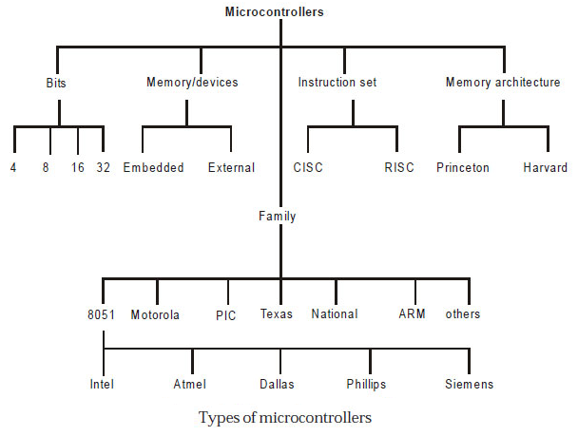
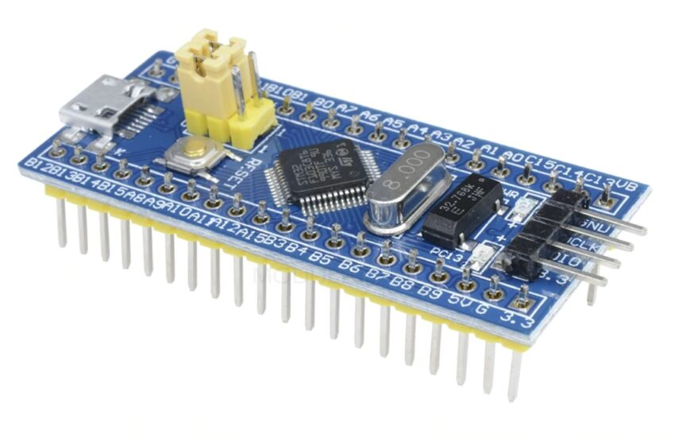
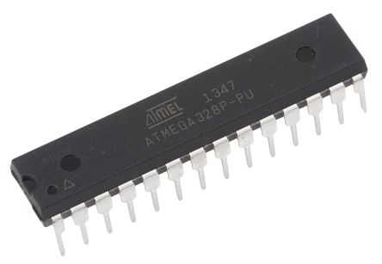
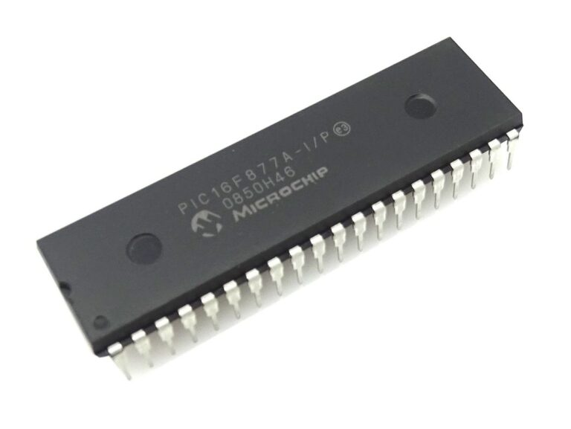
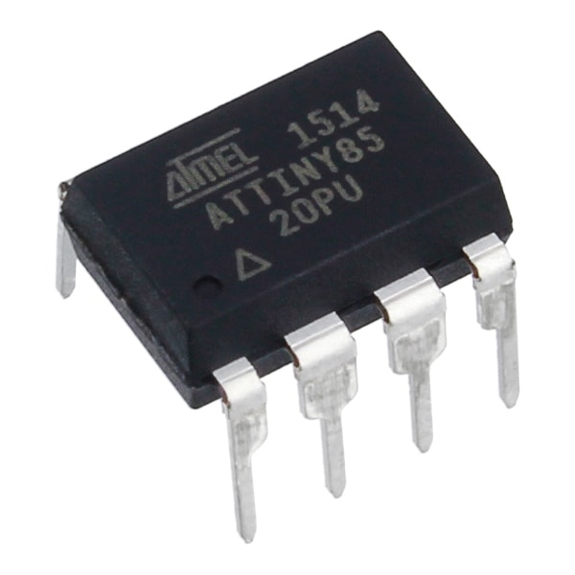
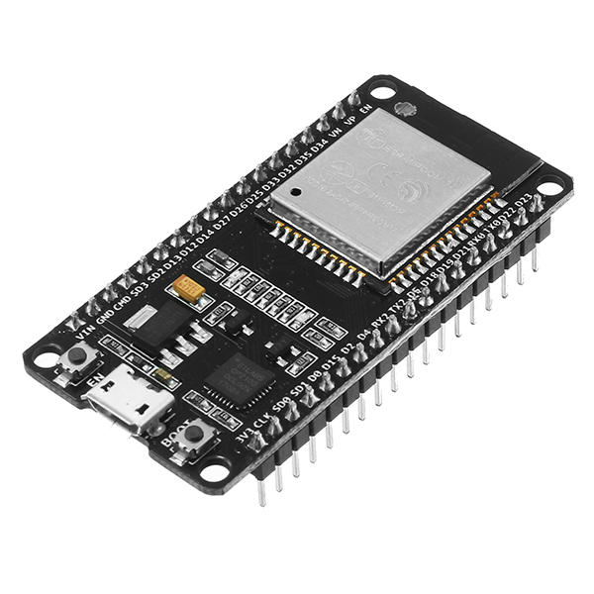
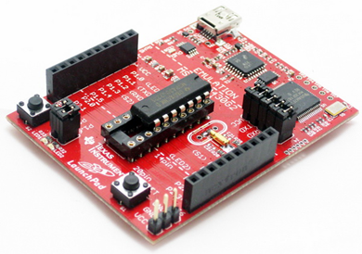
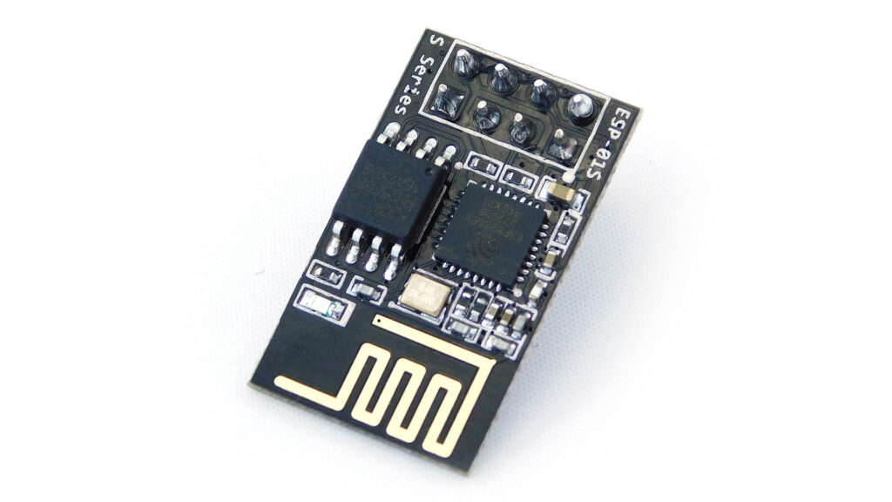
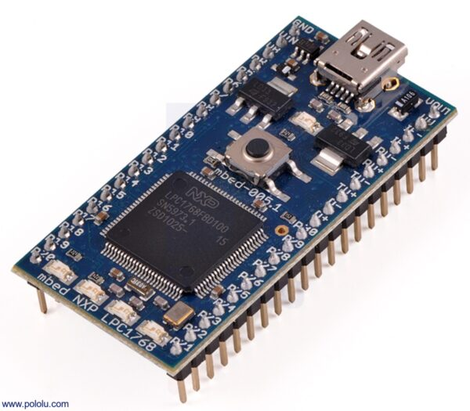
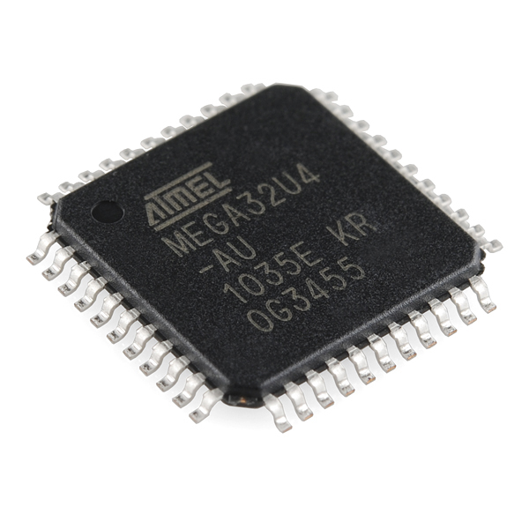
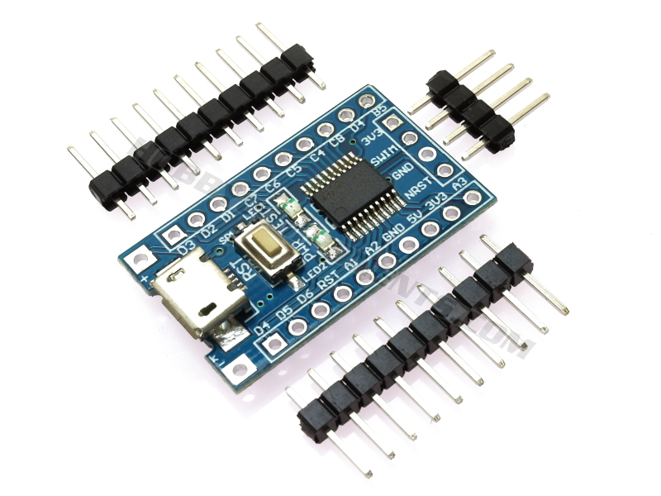
Categories of MCU
Figure-STM32F103C8T6
Figure- Attiny85
Figure-ATmega328
Figure- PIC16F877A
Figure- MSP430G2452
Figure- ESP8266
Figure- ESP32
Figure- NXP LPC1768
Figure- ATMEGA32U4
Figure- ATMEGA32U4
Ref: [3]
B.Sc Project 2022

Slide 12
Categories of MCU
Figure-STM32F103C8T6
Figure- Attiny85
Figure-ATmega328
Figure- PIC16F877A
Figure- MSP430G2452
Figure- ESP8266
Figure- ESP32
Figure- NXP LPC1768
Figure- ATMEGA32U4
Figure- ATMEGA32U4
Ref: [3]
B.Sc Project 2022

Slide 13

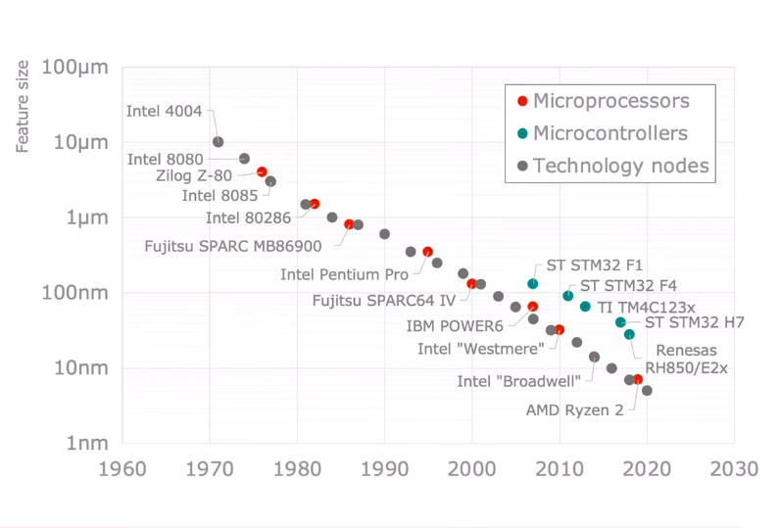
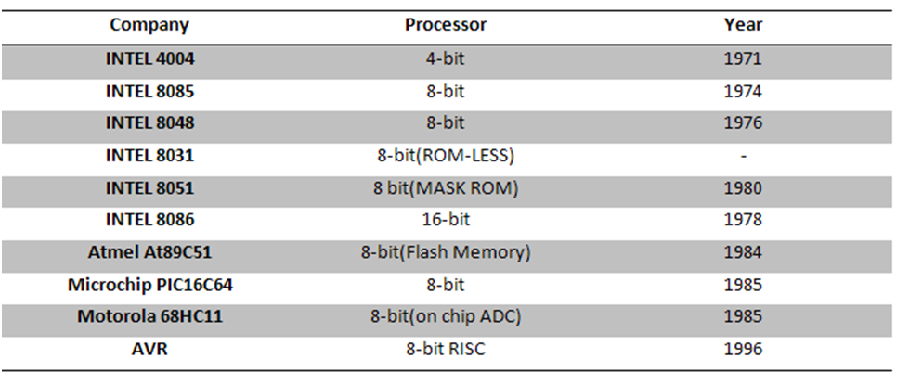
Microcontroller Evolution
Launched 2007
Microcontroller follow the main semiconductor technology trend
Figure-MCU Evolution[9]
The key requirements today
low power consumption
high integration density
Figure-MCU Evolution [8]
B.Sc Project 2022

Slide 14

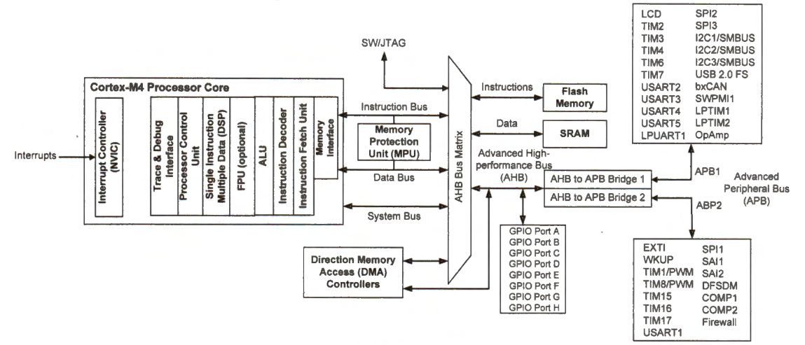
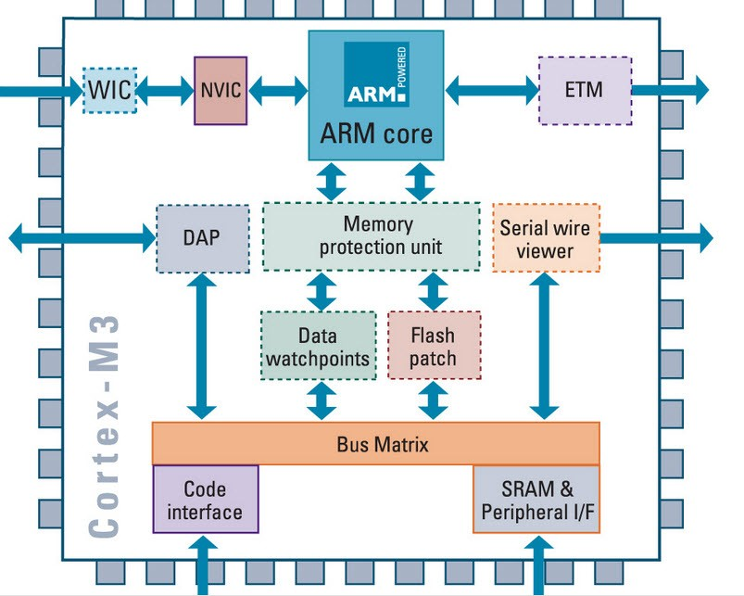
Architecture of ARM Processor
Figure-Block diagram of ARM processor
Figure-Organization of STM32L4 ARM Cortex-M4 processor
B.Sc Project 2022

Slide 15
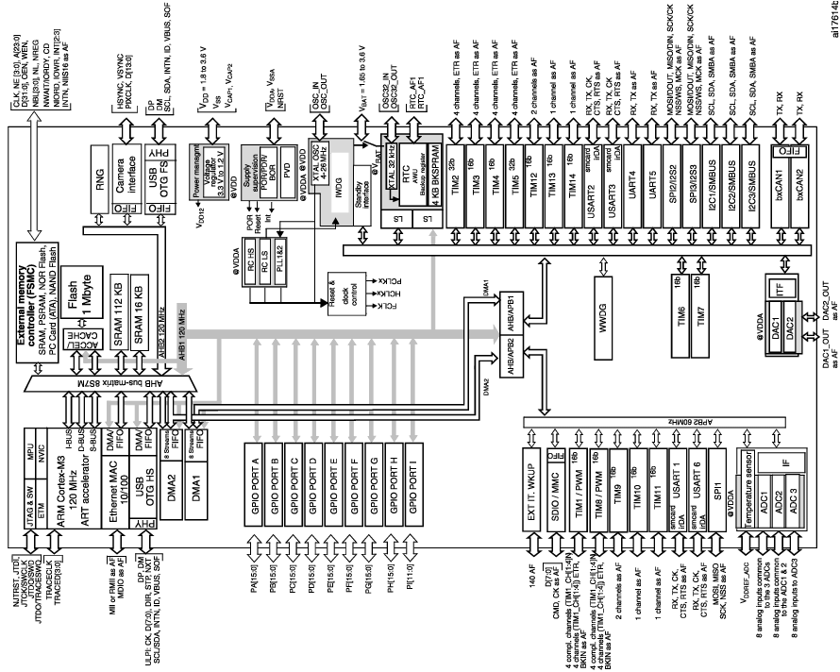
Architecture of ARM Processor - STM32 Microcontroller
Figure-Block diagram of STM32 microcontroller

